Slide 1
DDOS ATTACK DETECTION USING SUPERVISED MACHINE LEARNING TECHNIQUES
CS 5710: Machine Learning
CRN 22037
Group Project Presentation
Group Project Presentation

Slide 2
Group Member Information
Aravinda Krishna Gorantla - 700741775
Rakesh Karnekanti - 700745903
Dharani Atukuri - 700741812
Chandrakanth Bikumandla - 700726229
Group Project Presentation

Slide 3
Role/Responsibilities and Contribution in project
Rakesh Karnekanti, 700745903
Problem description and dataset formation: This phase includes the problem description and drafting of clear objectives and outcomes, and the dataset is gathered using the references.
Dharani Atukuri, 700741812
Data analysis and null value management: This phase includes the dataset loading and listing the required modules in the python and then checking for the null values and filling them using the mean value.
Chandrakanth Bikumandla, 700726229
Exploratory Data Analysis: Here all the columns in the dataset are studied well and correlation matrix and graphs are generated to finalize the features for modeling.
Aravinda Krishna Gorantla, 700741775
Model training: Here in this phase all the available functions and classes available in the Sklearn module that are useful for our project are studied.

Slide 4
Motivation
Web application security is an endless game of cat and mouse. A web application is a computer software that utilizes web technology and web browsers to operate over the Internet. A web application basically needs three components, a web server to handle client requests, an application server to carry out the activities, and a database to store the data. Web attacks can pose a major threat to a web application. They obtain access to the application DB and cause significant harm by taking advantage of the application's vulnerability. ML algorithms can recognize various patterns in both malicious and legitimate requests, and they are successful at predicting them in real-world situations.

Slide 5
Objectives
The objective of this study is to detect DDoS attacks using supervised machine learning techniques. A machine learning-based classification model can distinguish between "attack" and "regular" network flow conditions, and determine if new, unlabeled network traffic is malicious or benign.
The model can generalize three common assault techniques: User Datagram Protocol (UDP), Internet Control Message Protocol (ICMP), Transmission Control Protocol-SYN (TCP-SYN) flood attacks.
The processing steps of this method involve abstracting the network data stream into feature vectors, assigning each vector a label ranging from 0 to 1, and using a suitable classification method to learn from sample data, create a classification model, and categorize new, unlabeled network traffic.
The model can identify UDP-based attacks, which may cause data corruption in packets, but do not address other packet-related issues, such as lost or out-of-order packets.

Slide 6
Related work
For DDOS attack detection, the traditional method involves counting the total number of packets and identifying the source of the packets, without considering the specific protocol that the attack is using. This enables us to know if the DDOS has occurred but takes time for root diagnosis and take required action.

Slide 7
Problem Statement
The increasing number of insecure Internet of Things (IoT) devices connected to the internet poses a security threat, as they can be exploited by botnets to conduct DDoS attacks on critical internet infrastructure. To detect these attacks, new techniques are needed. This research focuses on studying DDoS attacks by botnet-infected IoT devices using multiple machine-learning classifiers, including neural networks. The goal is to develop low-cost machine learning algorithms that can be used by home gateway routers or other network middleboxes to detect local IoT device sources of DDoS attacks using flow-based and protocol-agnostic traffic data. The study uses the SDN attacks dataset sourced from Wireshark and focuses on classifying three types of DDOS attacks: ICMP, TCP-Sync, and UDP. The research aims to classify all the data and identify the best algorithm with the highest accuracy for detecting these attacks.

Slide 8
Proposed Solution
Here we first categorized the given data into 3 different protocols that enable us to segregate the DDOS with the root cause i.e., ICMP, TCP_SYNC, and UDP and then building a model with high accuracy for detecting the attacks. The model will be developed using classification methods [LR, KNN, MLP, ID3] to learn from the sample data and then categorize new, unlabeled network traffic as benign or malicious. By doing this, we can diagnose the root cause of the attack and take appropriate action in real-time.
Notes:
LR – LogisticRegression, KNN – KNeighborsClassifier, MLP – MLPClassifier, ID3 - DecisionTreeClassifier

Slide 9
SDN Dataset
Preprocessing
Transmission Control Protocol (TCP)
User Datagram Protocol (UDP)
Internet Control Message protocol (ICMP)
Feature Extraction
Training
Decision Tree (ID3)
Logistic Regression (LR)
Modelling
K-Nearest Neighbor (KNN)
Testing
Multilayer perceptron (MLP)
Result Analysis
Process Flow Diagram
Notes:
LR – LogisticRegression, KNN – KNeighborsClassifier, MLP – MLPClassifier, ID3 - DecisionTreeClassifier

Slide 10


ICMP Protocol
An Internet Control Message Protocol (ICMP) flood DDoS attack, also known as a Ping flood attack, is a common Denial-of-Service (DoS) attack in which an attacker attempts to overwhelm a targeted device with ICMP echo-requests (pings).
The attacker sends an ICMP echo request to the broadcast address
The victim floods with ICMP echo replies
Intermediary Network
Attacker
Victim

Slide 11
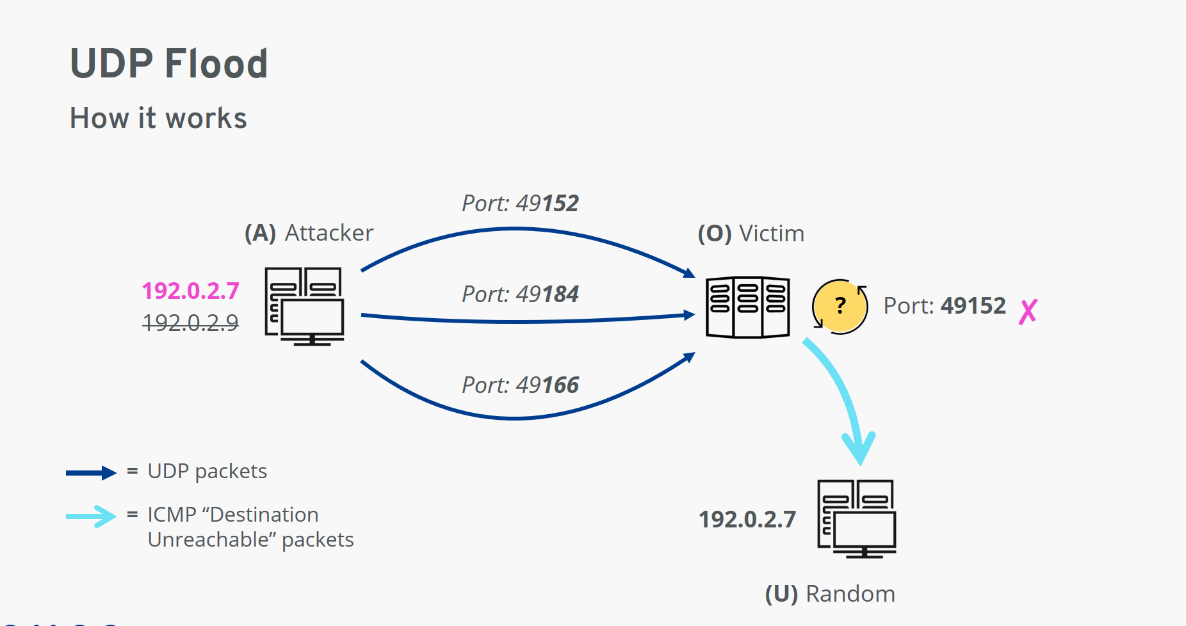
UDP Protocol
A UDP flood is a form of volumetric Denial-of-Service (DoS) attack where the attacker targets and overwhelms random ports on the host with IP packets containing User Datagram Protocol (UDP) packets.

Slide 12
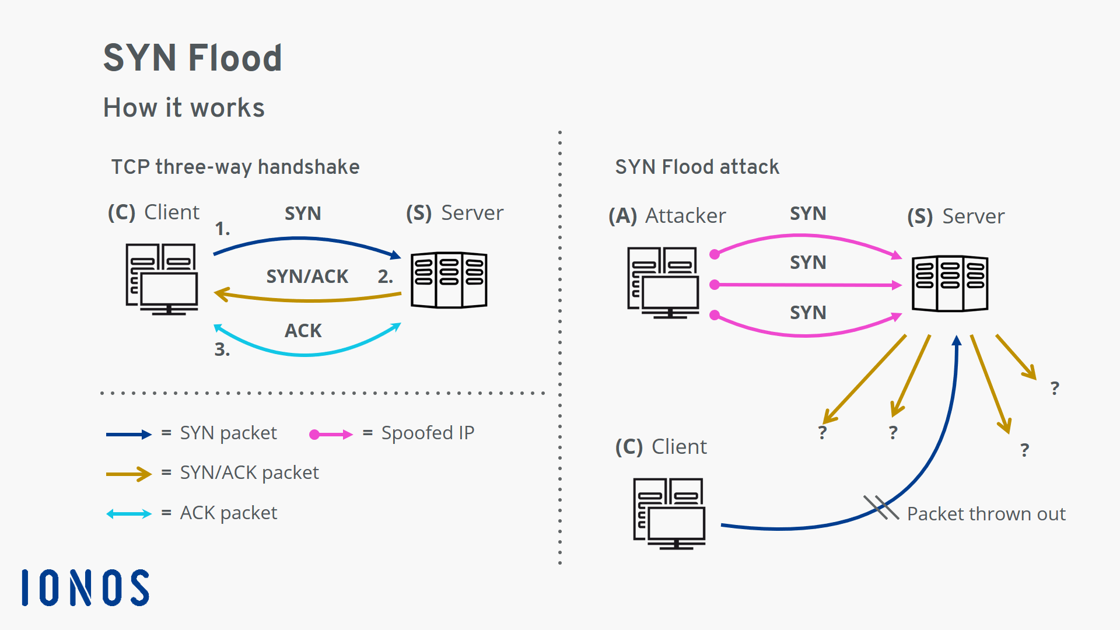
TCP_SYN Protocol
A SYN Flood is a common form of Denial-of-Service (DDoS) attack that can target any system connected to the Internet and providing Transmission Control Protocol (TCP) services (e.g., web server, email server, file transfer). Every connection using the TCP protocol requires the three-way handshake, which is a set of messages exchanged between the client and server.

Slide 13
Algorithm:
Step 1:
Collecting data and loading the dataset.
Step 2:
Extracting ICMP, UDP, and TCP-SYN packets from the dataset, and converting them to CSV format. Handling null values by imputing them.
Step3:
Extracting all the important features as a "priori“ for feature extraction.
Step4:
Considering ‘Features’ as $service, src_bytes, wrong_fragment, count, urgent, num_compromised,$ $srv_count$ and the ‘Target’ as $Result$ from the available data.
Considering ‘Features’ as 𝑠𝑒𝑟𝑣𝑖𝑐𝑒, 𝑠𝑟𝑐_𝑏𝑦𝑡𝑒𝑠, 𝑤𝑟𝑜𝑛𝑔_𝑓𝑟𝑎𝑔𝑚𝑒𝑛𝑡, 𝑐𝑜𝑢𝑛𝑡, 𝑢𝑟𝑔𝑒𝑛𝑡, 𝑛𝑢𝑚_𝑐𝑜𝑚𝑝𝑟𝑜𝑚𝑖𝑠𝑒𝑑, 𝑠𝑟𝑣_𝑐𝑜𝑢𝑛𝑡 and the ‘Target’ as 𝑅𝑒𝑠𝑢𝑙𝑡 from the available data.
Step5:
Replacing all classes of attacks with 1 and normal results with 0 in the ICMP, UDP, and TCP-SYN dataframes.
Step6:
Find some covariance between certain features to plot a covariance heatmap.
Step-7:
Split the data into training data and test data in 7:3 ratio.
Step-8:
Apply the Models like “LR, KNN, MLP, ID3” and find the confusion matrix for the features and then calculate the classification report (Accuracy, f1-score, precision, recall, support).

Slide 14
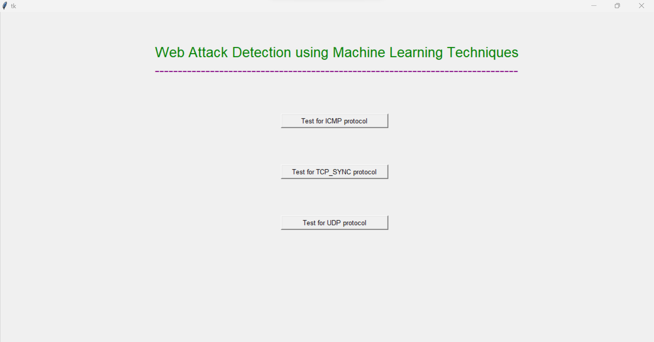
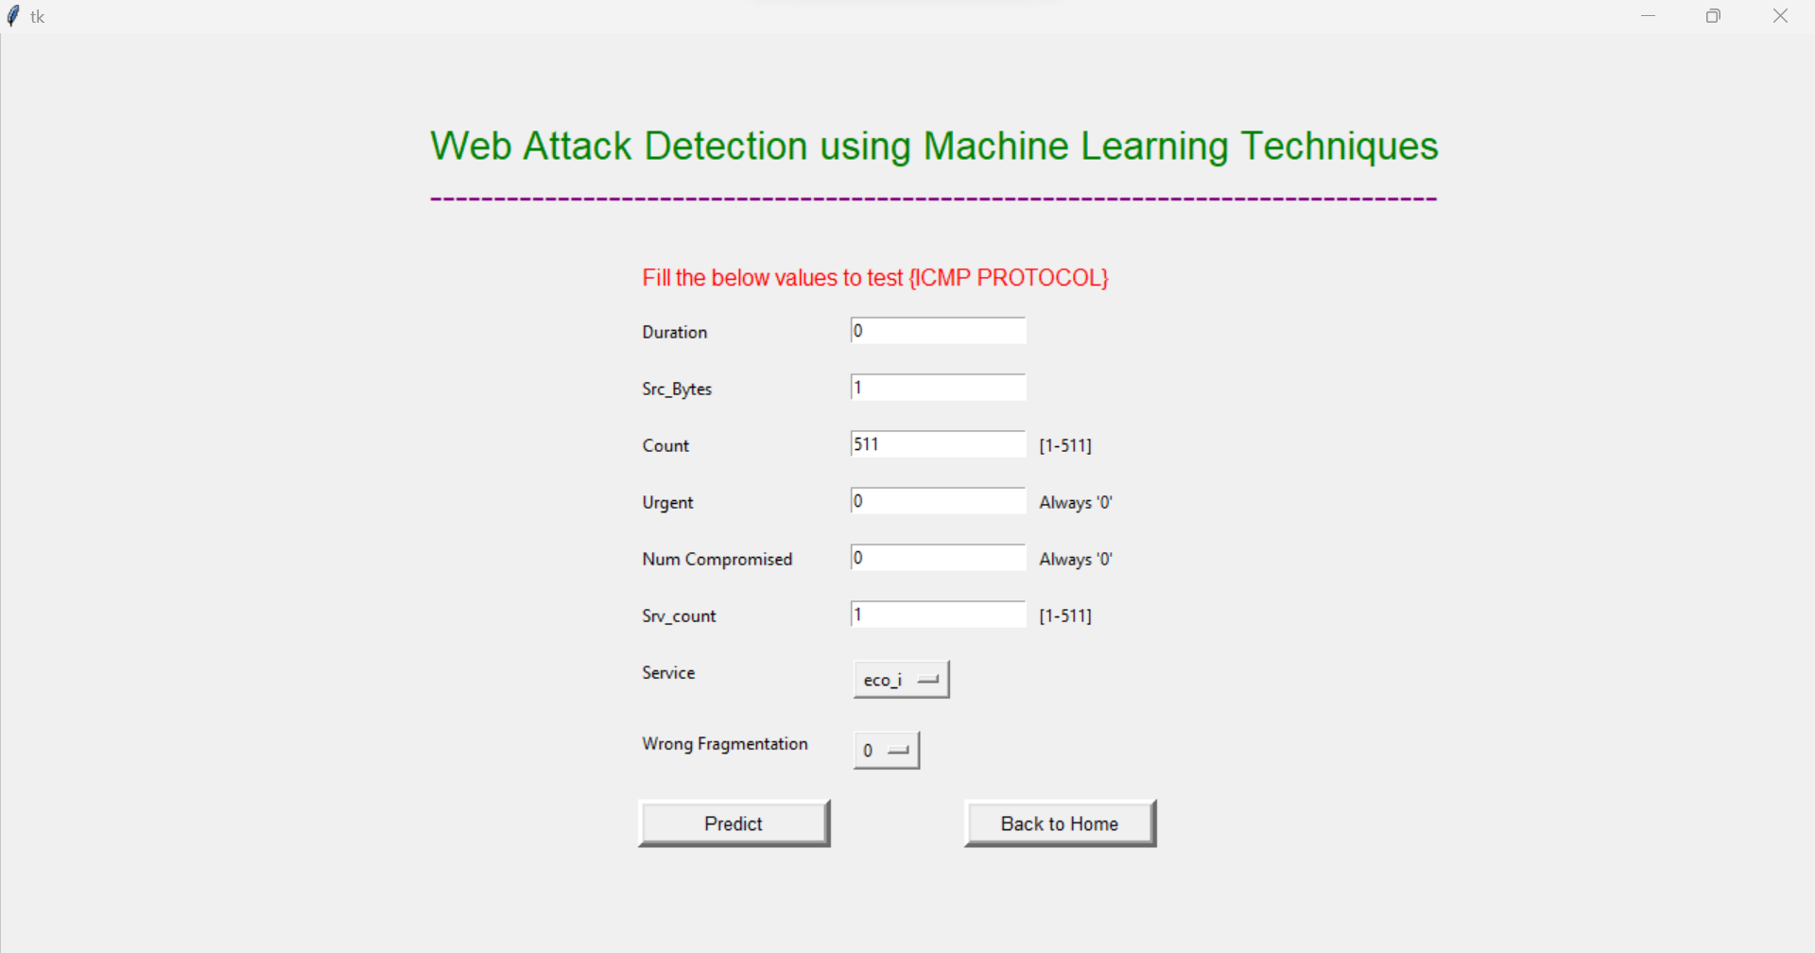
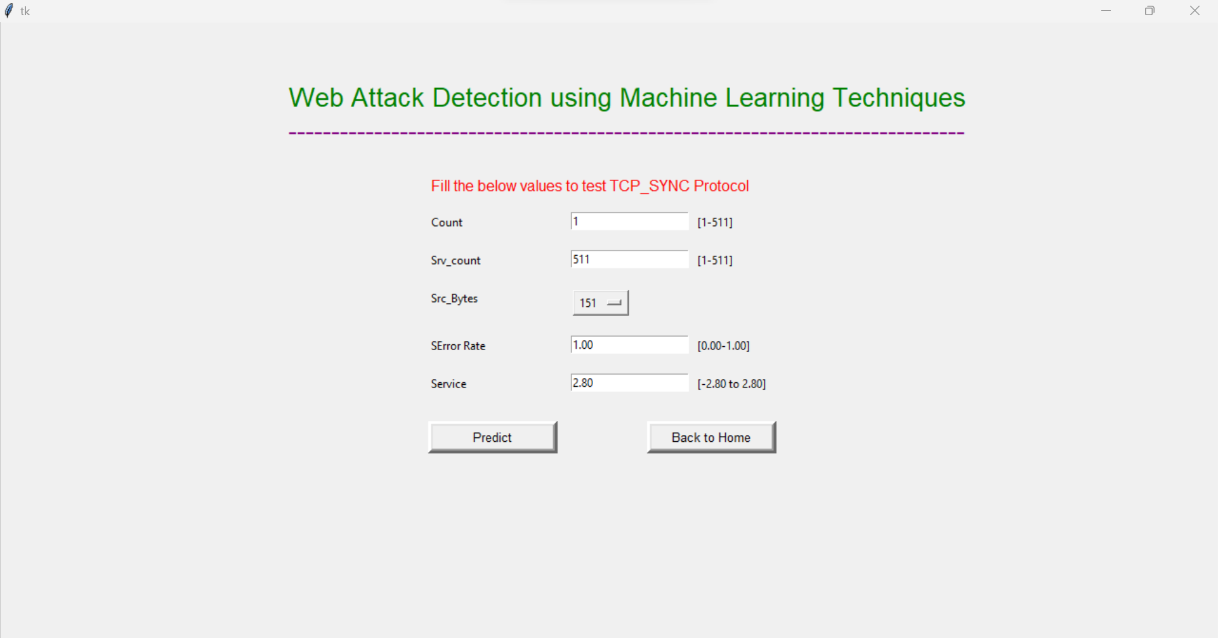
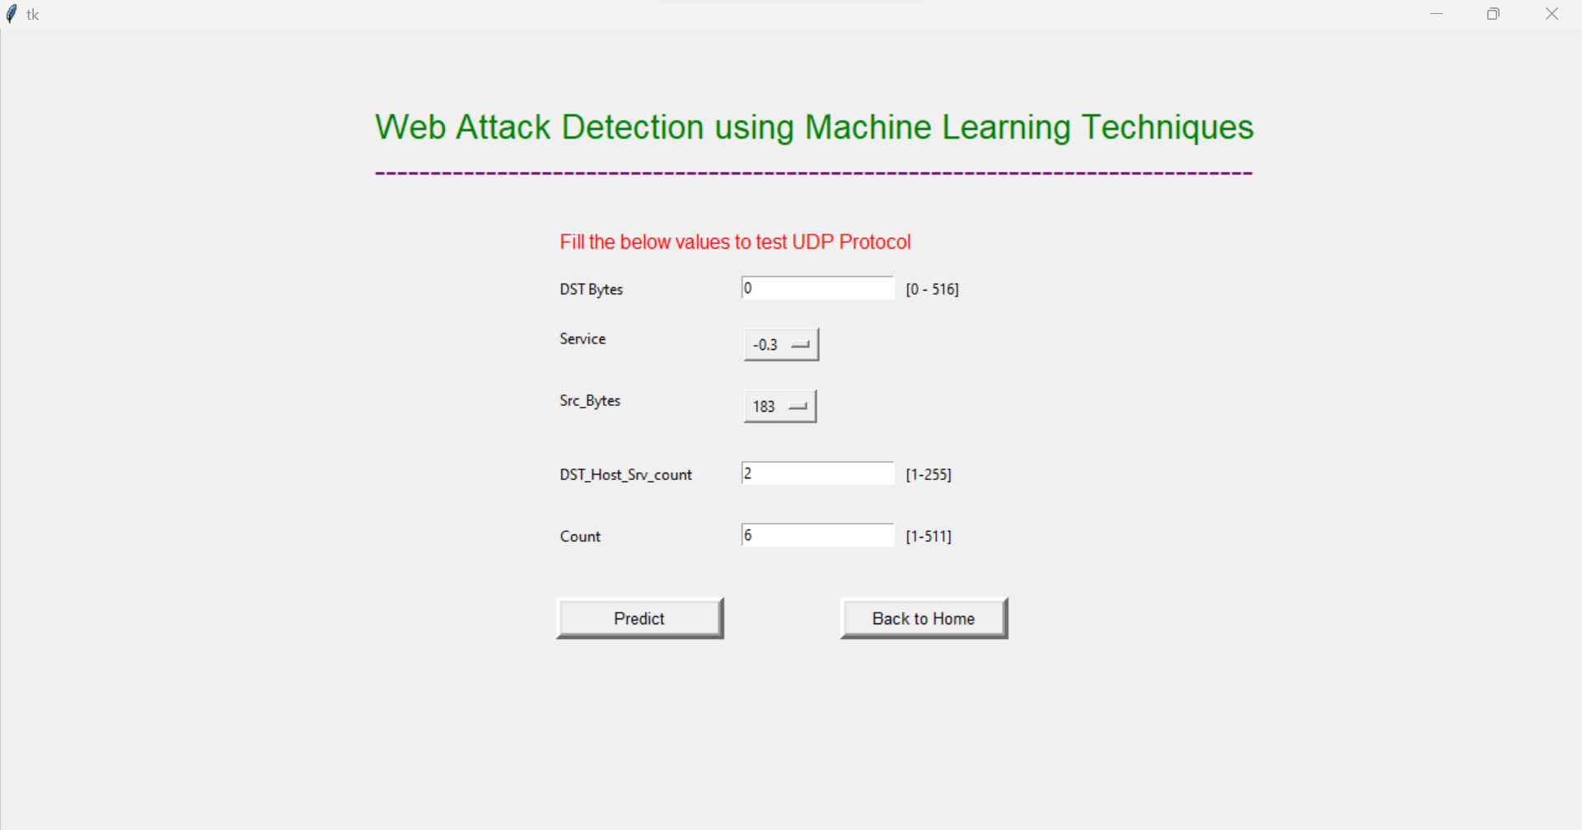
Results/Simulations:
Home Screen
ICMP
TCP_SYN
UDP

Slide 15
Conclusion:
In conclusion, we successfully preprocessed and labeled the SDN dataset to differentiate between normal and abnormal traffic. Our Python script helped identify missing features for common attacks, and feature extraction was crucial in determining the best input features. We utilized a correlation matrix to identify the optimal features and employed machine learning classifiers such as Logistic Regression, K-Nearest Neighbor, Id3, and Multilayer Perceptron to achieve the highest accuracy for detecting DDoS attacks. Our results demonstrate the effectiveness of using machine learning algorithms for detecting these types of attacks, which can help improve the security of IoT devices and protect critical Internet infrastructure.

Slide 16
References:
M NALAYINI, C., Katiravan, J. (2022). Detection of DDoS Attack Using Machine Learning Algorithms. Available at SSRN 4173187, 9(7).
“Detection of Ddos Attack using Machine Learning Algorithms” The international conference on emerging trends in engineering yukthi-2021,Govt.engineering college kozhikode, 24-26th september 2021
“Survey of Network-based Intrusion Detection Data Sets”, Markus Ring, Sarah Wunderlich. In this survey, they have classified that Labeled data sets are necessary to train and evaluate anomaly-based network intrusion detection systems,6 July 2019.
D. Chaudhary, K. Bhushan and B. B. Gupta, “Survey on DDoS attacks and defense mechanisms in cloud and fog computing”, Int. J. E-Services Mobile App., vol. 10, no. 3, pp 61-83, Jul. 2018.
Qianmu Li, Yanjun Song, Jing Zhang, Victor S. Sheng. “Multiclass imbalanced learning with one versus-one decomposition and spectral clustering”. Expert Systems with Applications, Volume 147,2020.

Slide 17

Thank you

